Slide 1

Parking Automation System
Sutthisak Sittipongvorakul
Senior Systems Engineer
Dell EMC Thailand

Slide 2

Original Idea
Parking Automation system
Using Proximity Sensor to detect availability of parking lot and keep status in Redis
Turn LED on/ off to notify driver
Showing parking status in web/mobile app for driver to check availability
Create reservation web page to let driver booking parking lot beforehand
Keep reservation in Redis and display car plate number using Segment display module
Publish to PCF for GA

Slide 3
What’s work?
Parking Automation system
Using Proximity Sensor to detect availability of parking lot and keep status in Redis
Turn LED on/ off to notify driver
Showing parking status in web/mobile app for driver to check availability
Create reservation web page to let driver booking parking lot beforehand
Keep reservation in Redis and display car plate number using Segment display module
Publish to PCF for GA

Slide 4
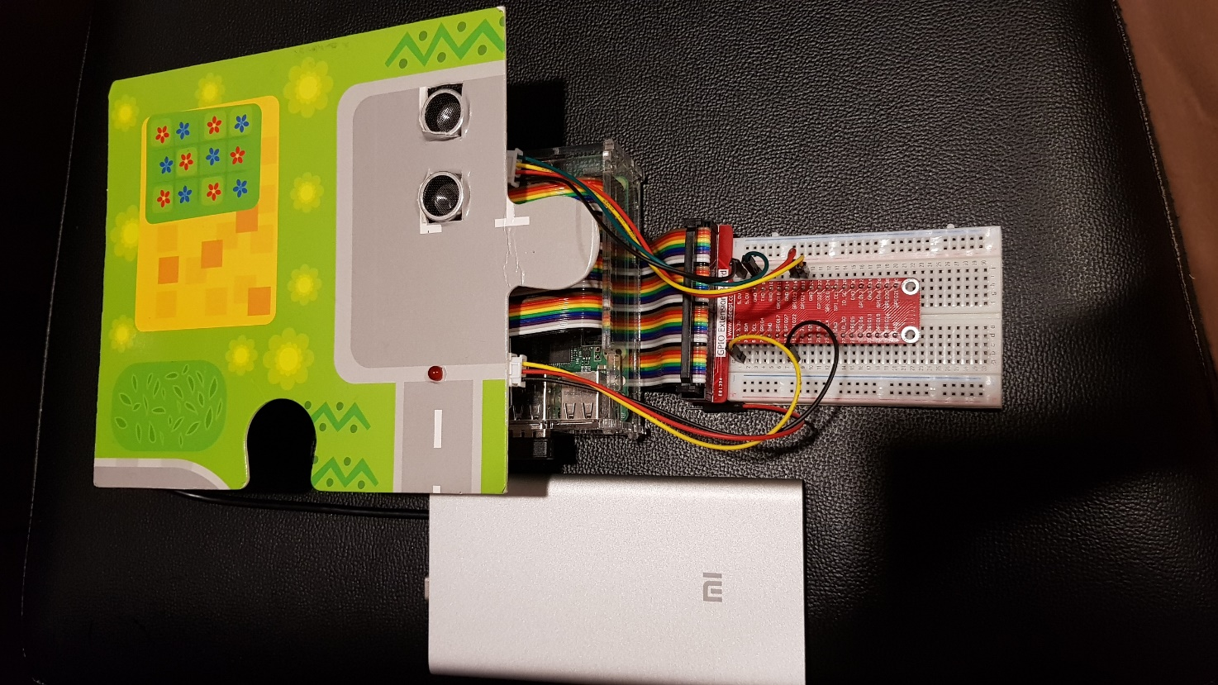
Equipment
Proximity Sensor
Raspberry PI
LED Status light
Power source

Slide 5
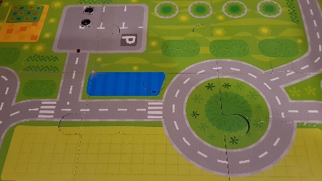
Overall Flow
Rasberry Pi
parking-publish.py
Mosquitto
Service
Python
mqtt-sub.py
Flask
Parking-reservation.py
Redis
Service
PARKING
LAPTOP
Notes:
There are more and better examples on how to do stuff in the Paho official repo:
https://github.com/eclipse/paho.mqtt.python/tree/master/examples

Slide 6
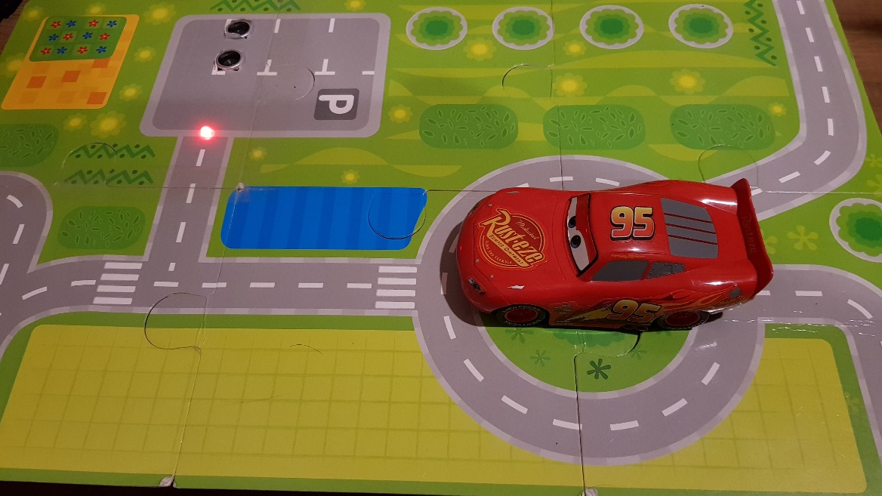
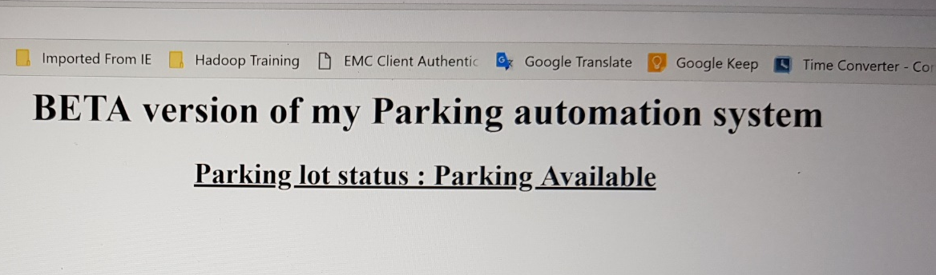
How this work
Proximity Sensor
LED Light
Proximity sensor detect if no car in parking lot, turn LED ON as available sign
Driver also can check from website on availability of parking lot

Slide 7
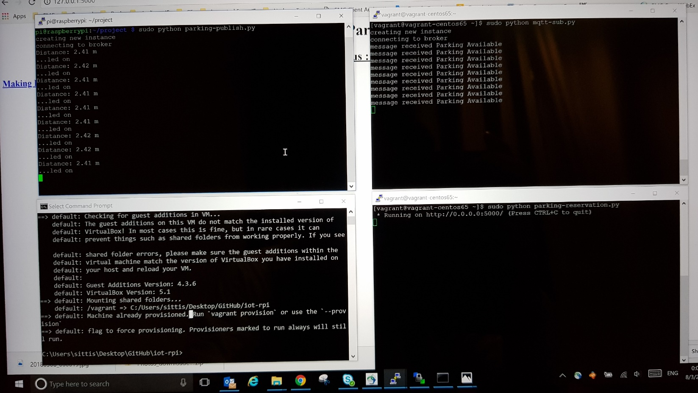
How this work
Mqtt-sub.py
Parking-publish.py
Vagrant for Redis
Parking-reservation.py

Slide 8
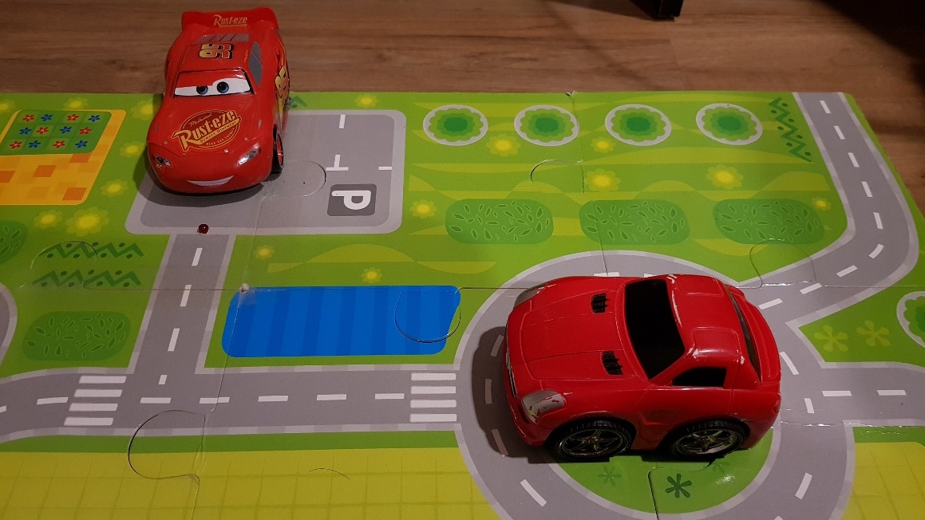
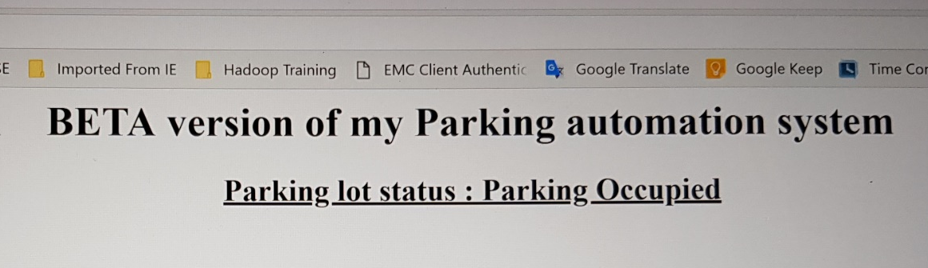
How this work
Proximity Sensor
LED Light
Proximity sensor detect parked car in parking lot, turn LED OFF as not available sign
Driver also can check from website on availability of parking lot

Slide 9
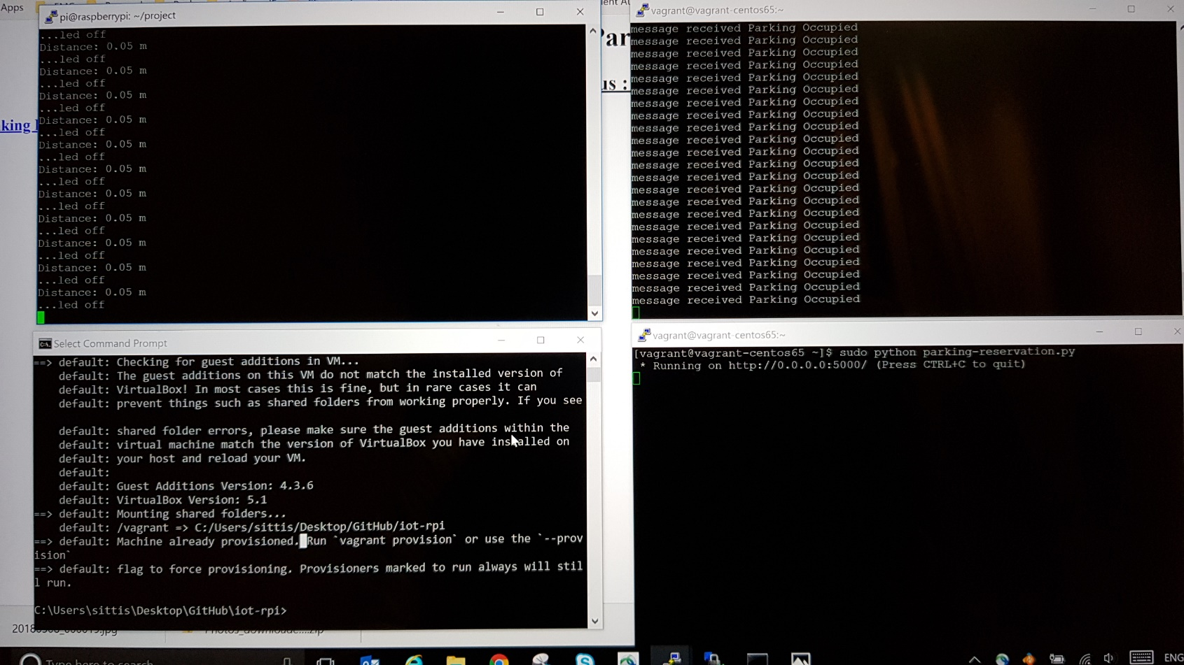
How this work
Mqtt-sub.py
Parking-publish.py
Car detected. Distance is lower than 1 m
Update Redis with Parking Occupied status
Vagrant for Redis
Parking-reservation.py

Slide 10
Demo

Slide 11
Improvement
Finish the reservation system and better UI for mobile app
Putting sensor/parking location for wider use with large parking space
Publish to PCF

